Slide 1

Academic Session 2025-26
EVEN Semester Jan-Jun 2026
UNIVERSITY INSTITUTE OF ENGINEERING
DEPARTMENT NAME-UIE
PROGRAM NAME:-Bachelor of Engineering
SPECIALIZATION/ SEMESTER-6th
SUBJECT NAME:-Principles of Artificial Intelligence
(SUBJECT CODE-23CST-306)
Unit No.2 Chapter No.2 Lecture No.18 and 19
Topic :Graph Theory and Search Strategies in Artificial Intelligence
Faculty Name-Er.Parveen kumar saini and E_Code -13339 Designation-AP

Slide 2
1
Learning Objectives
Understand and explain fundamental graph theory concepts, including vertices, edges, paths, cycles, and different types of graphs.
Understanding the differentiate between data-driven (forward chaining) and goal-driven (backward chaining) search strategies used in artificial intelligence.
Understanding graph-based search algorithms such as BFS, DFS, and A* to solve real-world problems in computer science and AI.

Slide 3
2
Recap of Previous Lecture
“Problem Solving and Search Techniques in Artificial Intelligence”

Slide 4
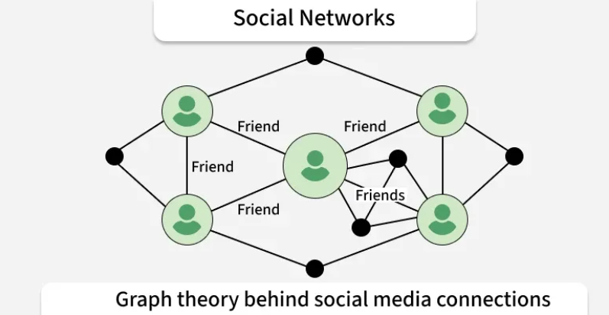
3
Introduction to Graph Theory
In many real-world situations, we often deal with a set of objects and the relationships between them.
For example, cities connected by roads, people linked through friendships, or computers connected in a network.
To study such relationships mathematically, we utilize graph theory.
Additional / Recommended Readings:
https://www.geeksforgeeks.org/maths/mathematics-graph-theory-basics-set-1/
Figure-1 : Applications of graph theory in real life

Slide 5
4
Graph Theory
Graph Theory is a branch of mathematics that deals with graphs—structures made up of vertices (points) and edges (lines). These graphs help us model and solve problems in computer science, engineering, biology, logistics, and many other fields.
Definition of Graph
A graph is a mathematical structure used to represent a set of objects and the connections between them:
The objects are called vertices ( or nodes),
The connections between them are called edges (or links).
Nodes: A finite non-empty set of points.
Edges: A set of pairs of vertices that represent the connections between them

Slide 6
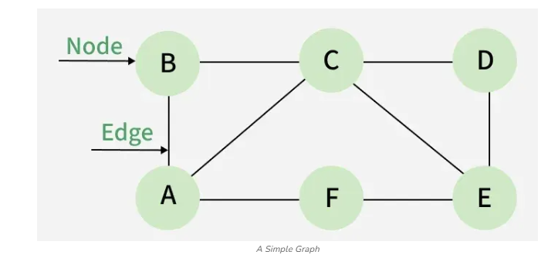
5
Simple Graph
Formally: A graph G is defined as: G - (V, E)
Where:
V = a set of vertices (or nodes), representing objects.
E = a set of edges (or links), representing connections between pairs of vertices.

Slide 7
6
Basic Concepts
Below are the basic terminologies used in graph theory.
Vertex (Node): A fundamental element of a graph, representing an object, entity, or point.
Edge (Link): A connection between two vertices, showing a relationship or pathway.
Adjacent Vertices: Two vertices that are directly connected by an edge.
Degree of a Vertex: The number of edges incident on a vertex.
In a directed graph, we distinguish between in-degree (incoming edges) and out-degree (outgoing edges).

Slide 8
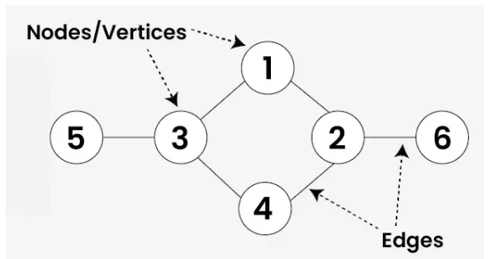
7
Basic Concepts
Path: A sequence of vertices connected by edges, with no vertex repeated.
Cycle: A path that begins and ends at the same vertex, forming a closed loop.
Connected Graph: A graph in which there exists a path between every pair of vertices.
Subgraph: A smaller graph formed using a subset of the vertices and edges of a larger graph.
Loop: An edge that connects a vertex back to itself.
Parallel Edges: Two or more edges that connect the same pair of vertices.

Slide 9
8
Explanation of the image below:
Explanation of the image below:
Vertex (Node): The circles labeled in the graph. Example: 1, 2, 3, 4, 5, 6 are vertices.
Edge (Link): The lines connecting two vertices. Example: The line between vertex 3 and 5 is an edge.
Adjacent Vertices: Vertices that are directly connected by an edge. Example: 3 and 5 are adjacent because they share an edge.
Degree of a Vertex: The number of edges incident on a vertex. Example: Vertex 3 has degree 3 (connected to 1, 4, and 5).

Slide 10
9
Explanation of the image below:
Explanation of the image below:
Path: A sequence of vertices connected by edges. Example: One path is 5 → 3 → 1 → 2 → 6.
Cycle: A path that starts and ends at the same vertex, without repeating edges. Example: 1 → 3 → 4 → 2 → 1 forms a cycle.
Connected Graph: A graph where there is a path between every pair of vertices. Example: From vertex 5, we can reach vertex 6 via 5 → 3 → 2 → 6, so this graph is connected.

Slide 11
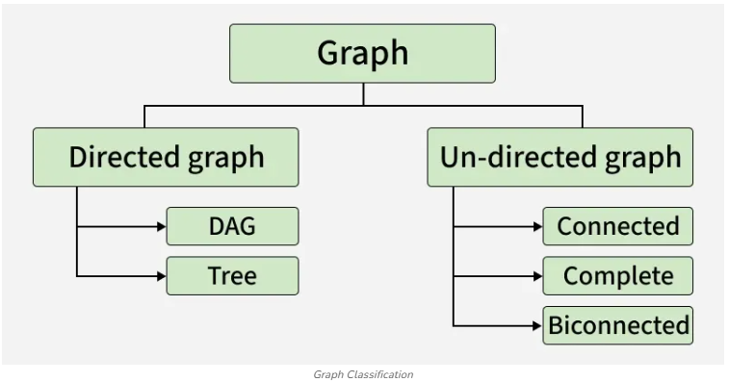
Types of Graphs
10
Graphs are of two types based on the type of edge, these are:

Slide 12
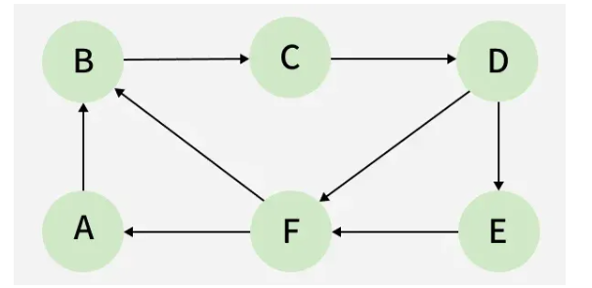
Let's discuss the types in detail.
12
Directed Graph
A graph in which the direction of the edge is defined for a particular node is a directed graph.

Slide 13
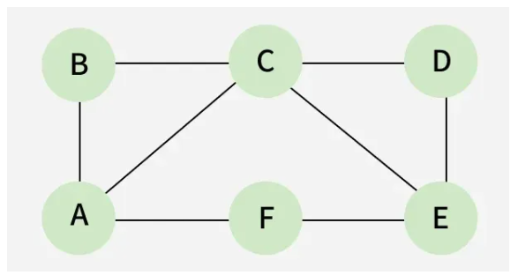
Directed Acyclic
12
Directed Acyclic: It is a directed graph with no cycle. For a vertex ‘v’ in DAG, there is no directed edge starting and ending with vertex ‘v’. The arrows go in one direction only (Directed), and you can’t go in a circle or loop (Acyclic).
Tree: A tree is just a restricted form of graph. That is, it is a DAG with a restriction that a child can have only one parent.
Undirected Graph
A graph in which the direction of the edge is not defined. So if an edge exists between node ‘u’ and ‘v’, then there is a path from node ‘u’ to ‘v’ and vice versa.

Slide 14
Example of Graph
13
Connected graph: A graph is connected when there is a path between every pair of vertices. In a connected graph, there is no unreachable node.
Complete graph: A graph in which each pair of graph vertices is connected by an edge. In other words, every node ‘u’ is adjacent to every other node ‘v’ in graph ‘G’. A complete graph would have n(n-1)/2 edges.
Biconnected graph: A connected graph that cannot be broken down into any further pieces by the deletion of any vertex. It is a graph with no articulation point.

Slide 15
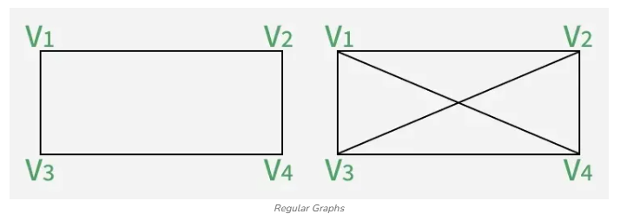
Some Important Graphs
14
1. Regular Graph: A graph in which every vertex x has the same/equal degree. A K-regular graph means every vertex has k edges. Every complete graph Kn will have (n-1)-regular graph, which means the degree is n-1.

Slide 16
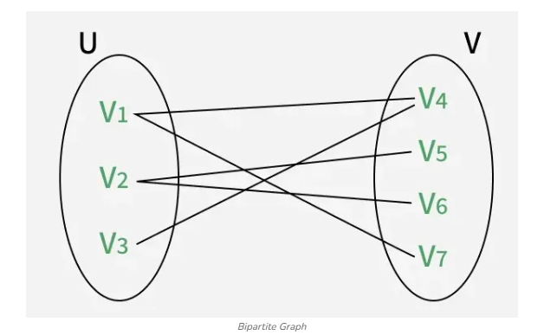
Bipartite Graph:
15
2. Bipartite Graph: It is a graph G in which the vertex set can be partitioned into two subsets U and V such that each edge of G has one end in U and another end point in V.

Slide 17
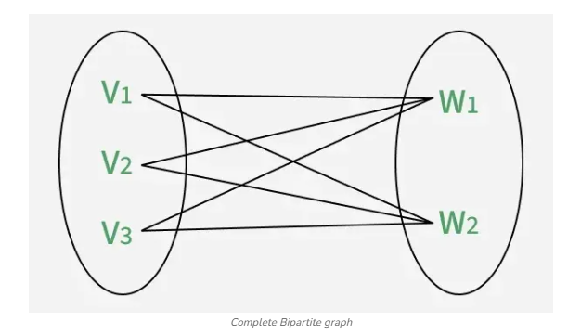
Complete Bipartite graph
16
3. Complete Bipartite graph: It is a simple graph with a vertex set partitioned into two subsets, u and w.
U = {v1, v2 , v3, ..., vm} and W = {w1, w2, w3, ..., wn}
The elements in these sets are the vertices.
1.There is an edge from each vi to each wj.
2.There is no self-loop.

Slide 18
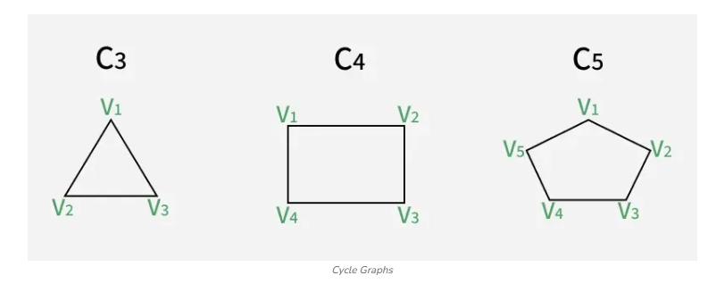
Cycle graph
17
4. Cycle graph: It is a connected graph where each vertex has degree 2, forming a single closed loop without any branches or endpoints. This graph contains at least 3 vertices. Suppose a graph has the following vertices:
v1, v2, v3, ..., vn
This graph will be a cycle graph if it has edges as follows:
(v1,v2), (v2,v3), (v3,v4), ..., (vn-1,vn), (vn,v1).

Slide 19
Applications of Graph Theory in CS
18
The major applications of Graph Theory in Computer Science are:
•Computer Networks – Graphs help in finding the shortest and most efficient path for data transfer between computers.
•Social Networks – People are nodes, and connections are edges. Graphs are used for friend suggestions and finding influencers.
•Operating Systems – Resource Allocation Graphs detect deadlocks by checking for cycles.
•Compiler Design – Control Flow Graphs show program execution flow, and graph coloring is used for register allocation.
•Search Engines (Web Graphs) – The internet is a huge directed graph of web pages. PageRank uses graph theory to rank search results.

Slide 20
Data-driven search in AI
19
Data-driven search in AI begins from the initial state and explores possible states forward until the goal state is reached, relying on available data to guide the process.
This approach is also known as forward chaining and is commonly used in scenarios with many possible states, such as pathfinding in navigation systems.
Algorithms like Breadth-First Search (BFS) and Depth-First Search (DFS) are typical examples of data-driven search methods.
While BFS guarantees the shortest path in unweighted graphs, it requires high memory usage.
DFS, on the other hand, is memory-efficient but does not guarantee the shortest path and may get stuck in infinite loops if cycles exist.

Slide 21
Data-driven search in AI
20
Data-driven search in artificial intelligence leverages machine learning and natural language processing to deliver more accurate, personalized, and context-aware results by understanding user intent and analyzing vast datasets.
This approach enables search engines to move beyond simple keyword matching, offering smarter responses to complex, conversational queries and integrating features like voice and image search.

Slide 22
Role of Artificial Intelligence in Modern Search Engines
21
AI-powered search engines use advanced technologies such as machine learning and natural language processing (NLP) to interpret user queries, identify context, and deliver relevant results tailored to individual needs.
These systems analyze patterns in user behavior, content quality, and engagement metrics to rank web pages, ensuring that high-value, trustworthy content appears first.
Features like Google’s MUM (Multitask Unified Model) allow the processing of information across text, images, and videos to answer multi-layered questions, such as comparing hiking preparations for different mountains based on prior experience.

Slide 23
Role of Artificial Intelligence in Modern Search Engines
22
AI also enhances search through visual and voice recognition, enabling users to upload images or ask spoken questions to receive precise, relevant results, such as identifying plants or translating foreign dishes.
The integration of AI in search is transforming user experiences by providing real-time, personalized results and improving accessibility, particularly for travelers, students, and international users.
Future developments may include privacy-preserving techniques like federated learning and differential privacy, allowing personalization without extensive data collection.

Slide 24
Goal-driven search
23
In contrast, goal-driven search starts from the goal state and works backward to determine the initial state, reasoning backward through sub-goals and rules to reach the starting point.
This method is also referred to as backward chaining and is particularly effective when the goal is well-defined, such as in planning and decision-making tasks.
It is often more efficient in large search spaces when the goal is clear, as it avoids exploring irrelevant paths.
A classic example of a goal-driven algorithm is backward chaining, used in rule-based expert systems.

Slide 25
Goal-driven search
24
The choice between data-driven and goal-driven search depends on the problem context.
Data-driven search is suitable for problems where the initial data is rich and the goal is not clearly defined, while goal-driven search excels when the objective is known and the search space is large but can be narrowed down through backward reasoning.
Both approaches are supported by informed and uninformed search algorithms, with informed methods using heuristics to improve efficiency.
For instance, A* graph search combines the cost to reach a node and the estimated cost to the goal, ensuring optimality and completeness when the heuristic is admissible

Slide 26
Goal-driven search
25
Goal-driven search in artificial intelligence refers to a problem-solving approach where the search process is directed towards achieving a specific goal state, using available information to guide the path efficiently.
This type of search is a core component of informed search algorithms, which leverage heuristics—estimates of the cost to reach the goal from a given state—to prioritize the most promising paths and avoid exploring less relevant areas of the search space.
The primary objective is to find a solution as quickly and efficiently as possible, often guaranteeing optimality if the heuristic used is admissible and consistent.

Slide 27
Goal-Driven (Informed) Search Algorithms in Artificial Intelligence
26
Goal-driven search is a defining characteristic of informed search algorithms, which use domain-specific knowledge to direct the search process toward the goal.
Algorithms like A* search and Greedy Best-First Search are prominent examples of goal-driven strategies that use heuristic functions to estimate the distance to the goal.
The effectiveness of goal-driven search depends heavily on the quality of the heuristic function; a good heuristic can drastically reduce the number of nodes explored and improve performance.
In contrast to uninformed (blind) search methods like BFS or DFS, which explore the search space systematically without guidance, goal-driven search is more efficient, especially in large or complex problem spaces

Slide 28
Comparison of Data-Driven Search (Forward Chaining) Goal-Driven Search (Backward Chaining)
27
Aspect | Data-Driven Search (Forward Chaining) | Goal-Driven Search (Backward Chaining)
Starting Point | Begins from the initial state or available data | Begins from the goal state
Direction of Search | Moves forward toward the goal | Moves backward toward the initial state
Alternate Name | Forward Chaining | Backward Chaining
Search Strategy | Explores all possible states derived from current data | Focuses only on states relevant to achieving the goal
Goal Knowledge | Goal may be unknown or loosely defined | Goal is clearly defined
Efficiency | May explore many irrelevant states | More efficient when the goal is well specified

Slide 29
Comparison of Data-Driven Search (Forward Chaining) Goal-Driven Search (Backward Chaining)
28
Aspect | Data-Driven Search (Forward Chaining) | Goal-Driven Search (Backward Chaining)
Search Space Handling | Suitable when data is rich and dynamic | Suitable when search space is large but goal is specific
Typical Algorithms | Breadth-First Search (BFS), Depth-First Search (DFS) | A*, Greedy Best-First Search, Backward Chaining
Use of Heuristics | Generally uninformed (no heuristics) | Often informed using heuristic functions
Memory Usage | BFS uses high memory, DFS uses less | Depends on heuristic; usually more optimized
Optimality | BFS guarantees shortest path (unweighted graphs) | A* guarantees optimality with admissible heuristic
Risk Factors | DFS may enter infinite loops | Poor heuristic may reduce efficiency
Common Applications | Pathfinding, navigation systems, data mining | Planning, expert systems, decision making
Real-World Example | Web crawling, route exploration | Medical diagnosis systems, rule-based AI

Slide 30
29
Summary of the Lecture
Graph Theory provides a mathematical way to model relationships and connections using vertices and edges.
Graphs are widely used in computer networks, social media, operating systems, compilers, and search engines.
Different types of graphs exist, such as directed, undirected, cyclic, acyclic, bipartite, complete, and connected graphs.
Data-driven search (Forward Chaining) starts from the initial state and explores forward (e.g., BFS, DFS).
Goal-driven search (Backward Chaining) starts from the goal and reasons backward using heuristics (e.g., A*, Greedy Best-First Search).
The choice of search strategy depends on problem size, goal clarity, and available data.
Graph-based AI search techniques enable efficient problem-solving and intelligent decision-making.

Slide 31
30
Next Lecture
Depth-First and
Breadth-First Searches,
HEURISTIC SEARCHES

Slide 32
31
Quiz/ FAQ’s
What is the difference between a graph and a tree?
Why is BFS guaranteed to find the shortest path, but DFS is not?
What is the difference between directed and undirected graphs?
Why are graphs important in Artificial Intelligence?
When should we prefer data-driven search over goal-driven search?
What role do heuristics play in goal-driven search algorithms like A*?
Can a graph have both cycles and directed edges? Give an example.
8. How does graph theory help search engines like Google?

Slide 33
32
https://www.geeksforgeeks.org/maths/mathematics-graph-theory-basics-set-1/
https://www.geeksforgeeks.org/dsa/graph-theory-tutorial/
https://www.geeksforgeeks.org/dsa/graph-data-structure-and-algorithms/
References/ Articles

Slide 34
33
Faculty-curated videos, NPTEL, Coursera, LinkedIn, or other relevant learning resources
https://www.youtube.com/watch?v=LFKZLXVO-Dg
https://www.youtube.com/watch?v=VZFpA63C5yo

Slide 35

34
Class-Wise Feedback

Slide 36
35
Thank You
For queries
Email: parveen.e13339@cumail.in

